Slide 1
Project Presentation
Project Title : Object detection in twilight or night-time conditions
Project Guide : Prof. Rajini M.
Project Team : Chaitanya Lal (PES1201801324)
(Name,SRN) Shravan Bajaj (PES1201800421)
Jaya Raj (PES1201800317)

Slide 2
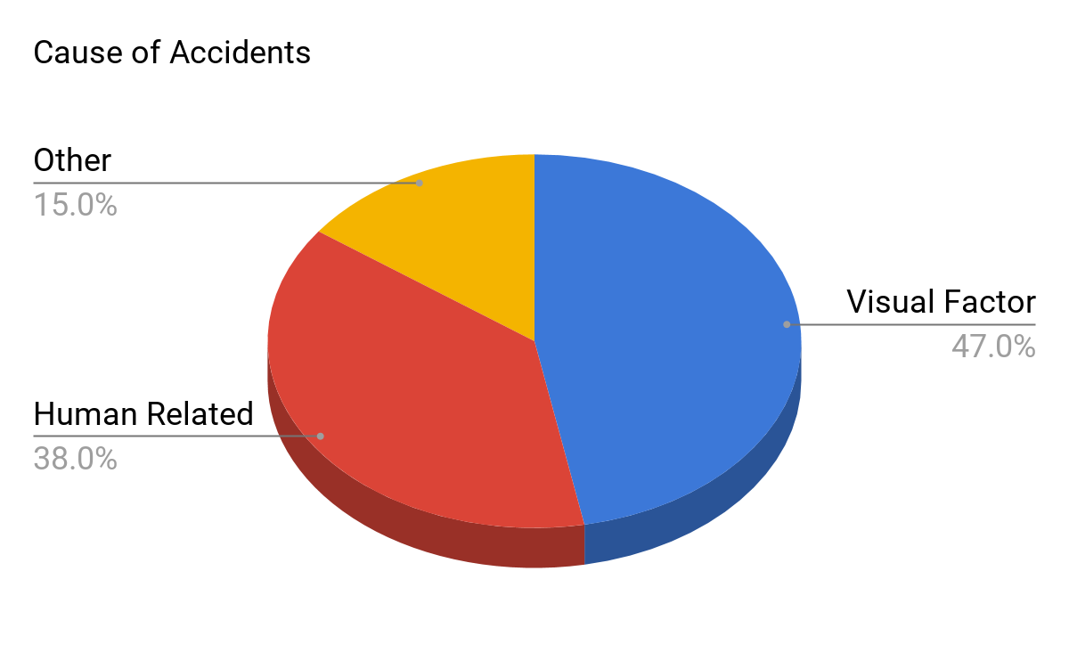
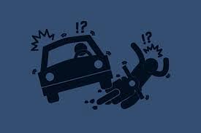
INTRODUCTION
“Despite 60% less traffic on roads, more than 40% of all fatal road accidents occur during night. ’’
Sources: seriousaccidents.com, Analysis of Prime Reasons for Night Time Accidents in Public Transport Corporations

Slide 3
Our Solution-
We have developed a system which can detect common objects like person, cars, bicycles, and other Indian vehicles like auto-rickshaws during the day, night time, and twilight conditions.

Slide 4
Non - Deep Learning
Tail Light Detection along with
Gamma Correction
Methods
Deep Learning
YOLOv3-SPP on Thermal Images

Slide 5
NON-DEEP LEARNING APPROACH

Slide 6
TAIL LIGHT DETECTION
Detects presence of vehicles that are in front of driver.
Lack of dataset for Indian vehicles in night
No dataset required
Tail lights are present in all vehicles
WHY THIS METHOD??
Common feature : Red tail lights tend to have a white colour at the Centre.

Slide 7
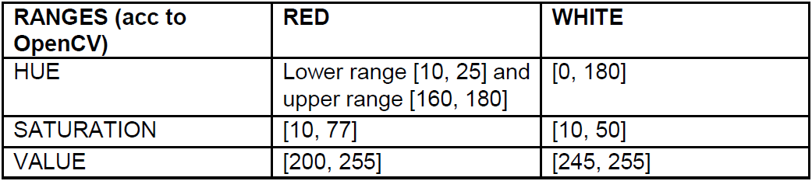
Methodology:
Convert frame format from BGR to HSV.
HSV Threshold values of red and white colours.

Slide 8
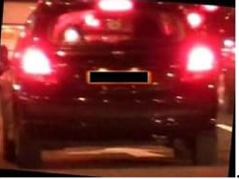
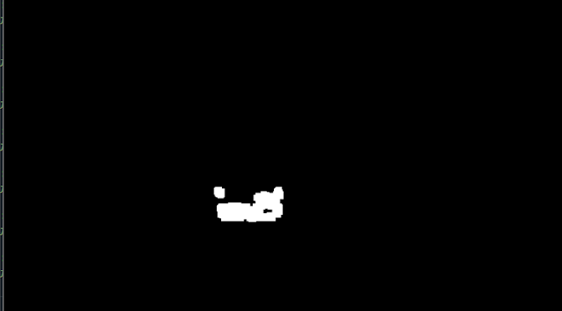
Masking the regions where white part lies adjacent to red ones indicating tail light.
Dilate and Smoothen the frame to get the morphed image.
Generating contours over the masked region.

Slide 9
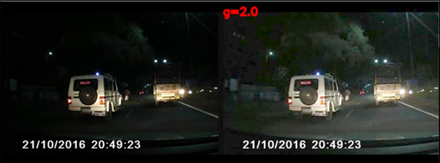
Converting suitable contours to rectangles.
Merging nearby rectangles to get bounding boxes over the tail-light part.
Gamma Correction Method to increase the visibility.
Adjusting the Gamma Value

Slide 10
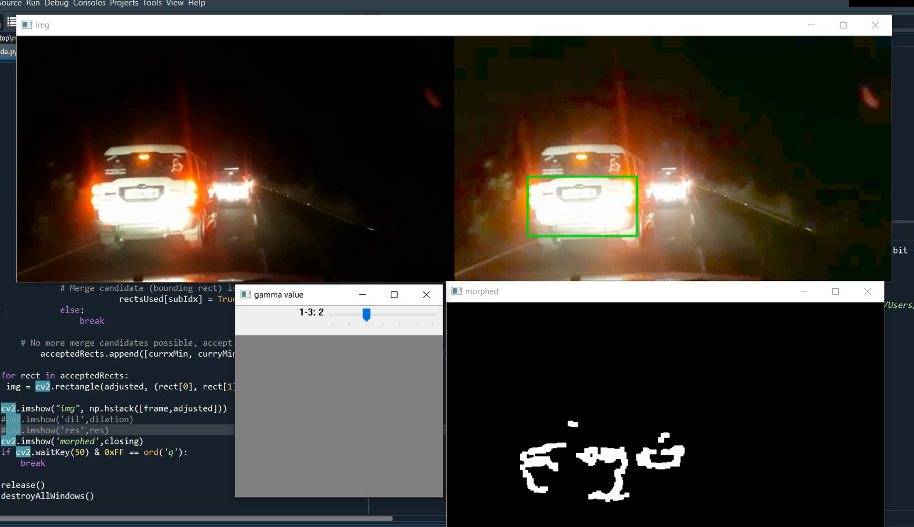
OUTPUT

Slide 11
DEEP LEARNING APPROACH

Slide 12
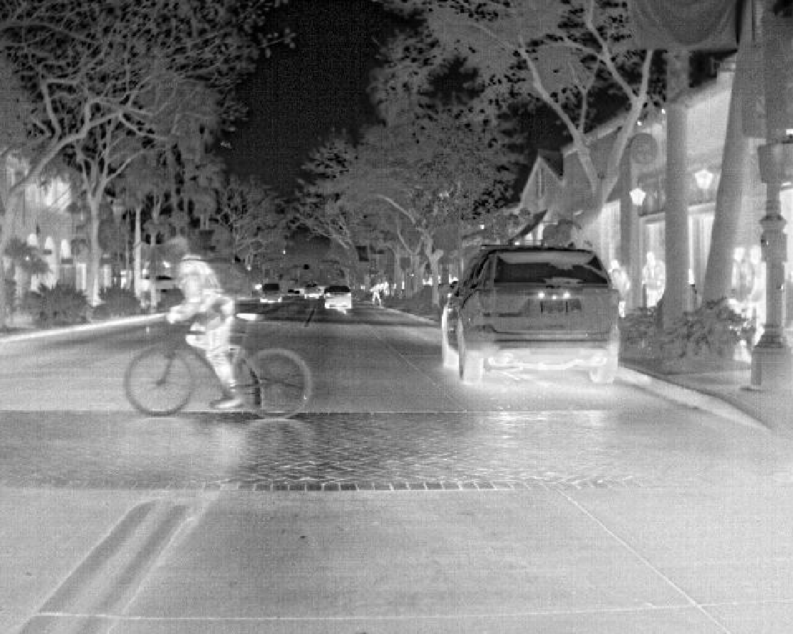
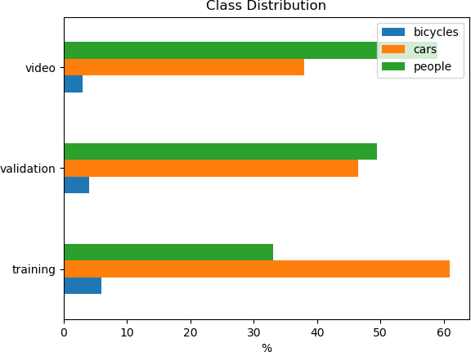
DATA SET
FLIR ADAS dataset
8-bit thermal 3 channels grey scaled jpeg format images.
8862 images for training.
Classes : Person, Bicycle, Car
Validation set : RGB and Grey scaled images.
WHY?
Thermal camera can see through fog and in low light.

Slide 13
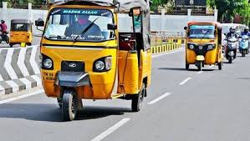
DATA SET
2) Indian auto-rickshaw dataset
Contains 800 images of auto-rickshaws
Published by IIIT-H.
Common on Indian Roads.

Slide 14
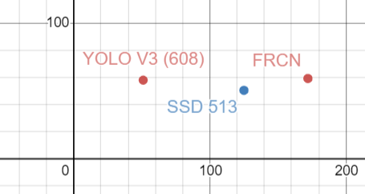
YOLOv3-SPP model
YOLOv3
You Only Look Once
(3rd Version)
Single Shot Object detection Algorithm
Darknet -53
Input Image Size - 608x608
Pre defined boxes called Anchors
WHY?
FAST - 20fps.
Better mAP score.
3 stages Detection
source :http://pjreddie.com/darknet/yolo
coco mAP score
Inference time (ms)

Slide 15
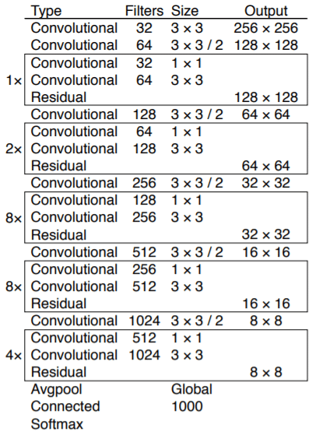
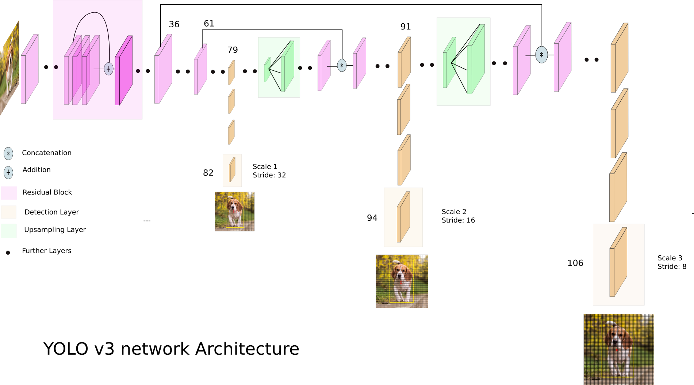
YOLOv3 Architecture
Darknet-53 Architecture
Sources: Towards Data Science, Yolo-v3 Paper

Slide 16
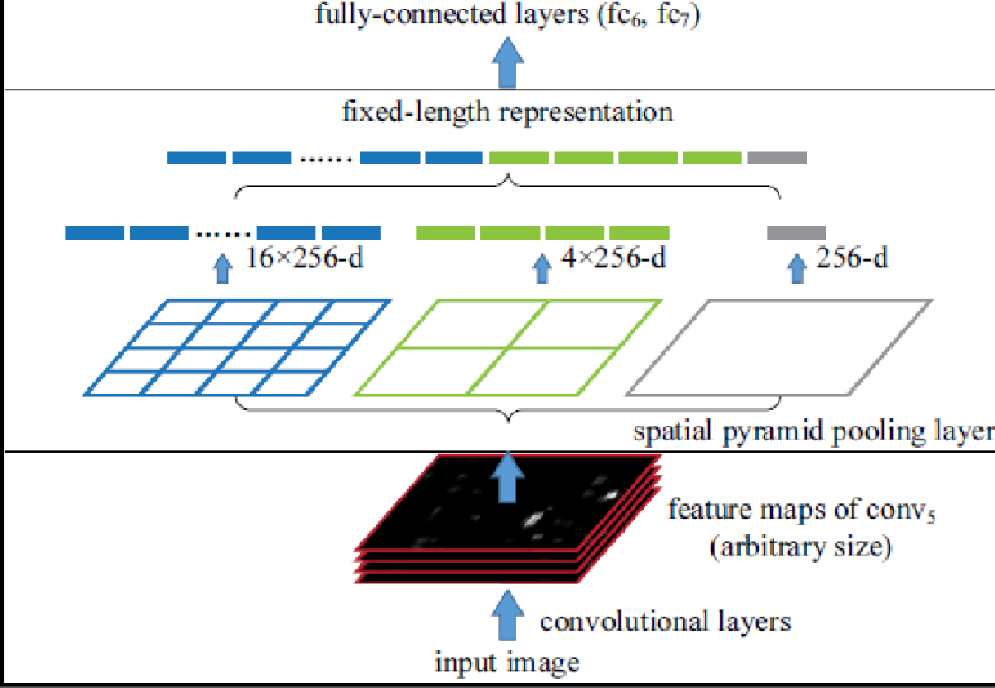
SPP Layer and Architecture
SPP layer :
Extracts the minute features to detect obstructed images.
Using Max-Pool layers on feature map output.
Process repeated at different levels.
Source: SPP net paper-
https://arxiv.org/pdf/1406.4729.pdf

Slide 17
Model Training:
Normalised annotations- centre(x,y)
<width> <height>- float values relative to width and height of image
Converted thermal_annotations.json to yolo format.
[[8, 18], [11, 27], [18, 44], [23, 49], [32, 66], [47, 97], [51, 104], [79, 143], [141, 170]]
Generated own set of anchor boxes using K-means clustering.
configured .cfg file (Contains network architecture) for 3 classes
Trained weights on 3600 iterations on Google Colab.
[ avg. loss - 2.68]

Slide 18
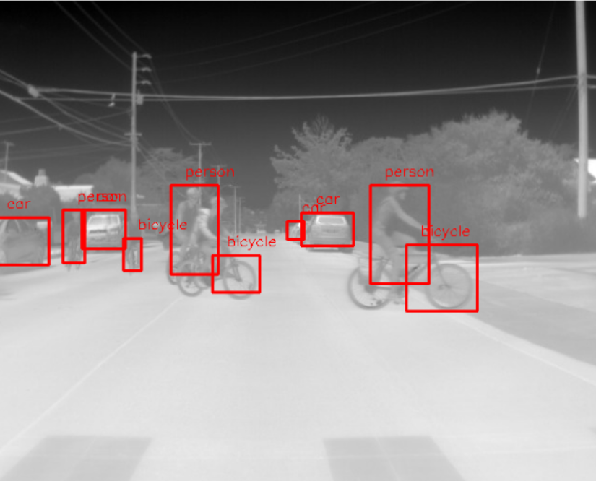
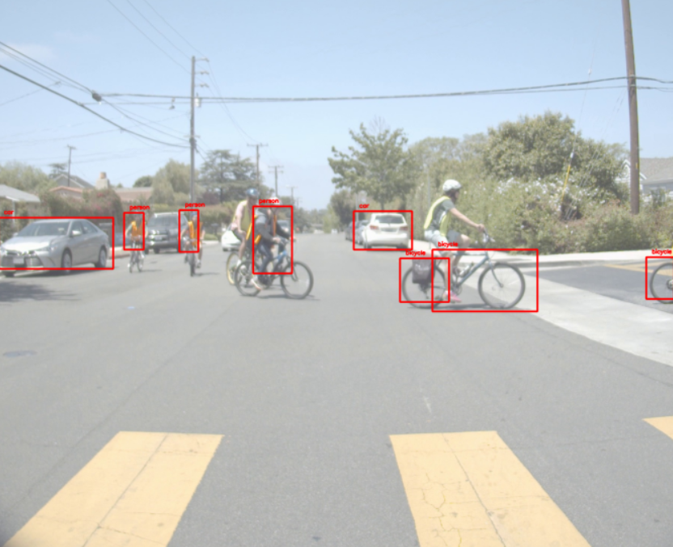
RESULTS

Slide 19
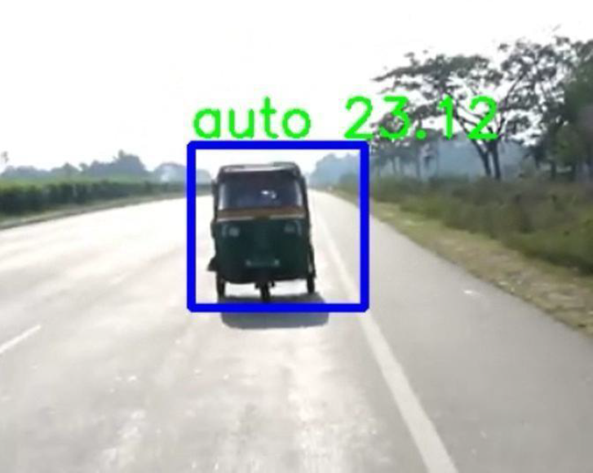
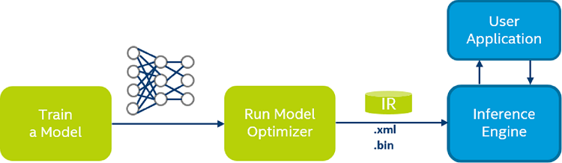
OpenVino:
Open Visual Inference and Neural network Optimization Toolkit.
Execute computer vision models across intel CPU, GPU, FPGA etc
Trained auto rickshaw dataset on darkflow tiny yolo model.
Flow-
Result
Source: Intel OpenVino website.

Slide 20
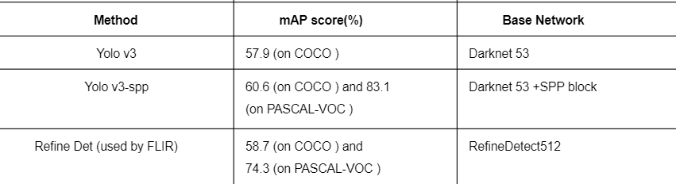
Analyzing the Results
During later stages of training, avg, IOU touching 75%.
Giving better accuracy than existing detection models.
Source: Internet

Slide 21
CONCLUSION
This project can be moulded into a product offering in the field of Object Detection in adverse conditions.
Benefitted areas can be Roadways and Transport, Logistics, Military etc.
Many other products and technologies can be built on the top of this concept.

Slide 22
THANK YOU!!

